Slide 1
Applied Statistics
week1
Nov 2017
Serkan Ceran
www.serkanceran.com
https://www.linkedin.com/in/serkan-ceran
@analytcman
All client case studies included in
this training are for internal use only

Slide 2

What are your expectations for this class?

Slide 3
Course Management
What to be learned?
Why we need statistics?
Descriptive statistics, Inferential statistics
How to be learned?
Udacity videos, presentations, lecture discussions
How to be evaluated?
Midterm 40%
Project 30%
Final 40%
Notes:
3
3

Slide 4
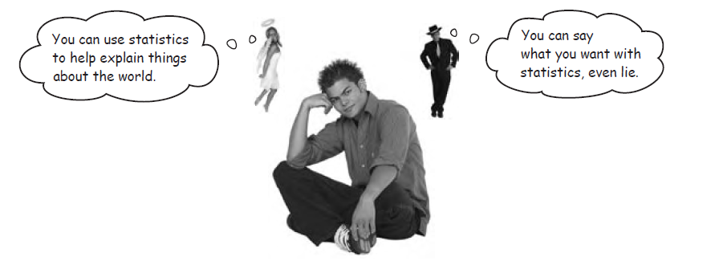
An important note before we start. . . .
Notes:
4
4

Slide 5
An important note before we start. . . .
Statistics is not a form of magic. It can not turn awful data into shining results. (“You feed rubbish in, you get rubbish out”)
It is important to think about results you want before collecting them, and not rely on stats to get you out of a hole later
Statistical techniques, if worked hard enough, can be abused to show pretty much anything you like
Experts on torture have pointed out that information you get from inflicting pain doesn't tend to be particularly reliable. This is something also applicable to statistics. . .
Notes:
5
5

Slide 6
STATISTICS in REAL LIFE
Weather Forecasts
Emergency Preparedness
Predicting Disease
Medical Studies
Genetics
Political Campaigns
Insurance
Consumer Goods
Quality Testing
Stock Market
Notes:
6
6
1. Weather Forecasts
Do you watch the weather forecast sometime during the day? How do you use that information? Have you ever heard the forecaster talk about weather models? These computer models are built using statistics that compare prior weather conditions with current weather to predict future weather.
2. Emergency Preparedness
What happens if the forecast indicates that a hurricane is imminent or that tornadoes are likely to occur? Emergency management agencies move into high gear to be ready to rescue people. Emergency teams rely on statistics to tell them when danger may occur.
3. Predicting Disease
Lots of times on the news reports, statistics about a disease are reported. If the reporter simply reports the number of people who either have the disease or who have died from it, it's an interesting fact but it might not mean much to your life. But when statistics become involved, you have a better idea of how that disease may affect you.
For example, studies have shown that 85 to 95 percent of lung cancers are smoking related. The statistic should tell you that almost all lung cancers are related to smoking and that if you want to have a good chance of avoiding lung cancer, you shouldn't smoke.
4. Medical Studies
Scientists must show a statistically valid rate of effectiveness before any drug can be prescribed. Statistics are behind every medical study you hear about.
5. Genetics
Many people are afflicted with diseases that come from their genetic make-up and these diseases can potentially be passed on to their children. Statistics are critical in determining the chances of a new baby being affected by the disease.
6. Political Campaigns
Whenever there's an election, the news organizations consult their models when they try to predict who the winner is. Candidates consult voter polls to determine where and how they campaign. Statistics play a part in who your elected government officials will be
7. Insurance
You know that in order to drive your car you are required by law to have car insurance. If you have a mortgage on your house, you must have it insured as well. The rate that an insurance company charges you is based upon statistics from all drivers or homeowners in your area.
8. Consumer Goods
Wal-Mart, a worldwide leading retailer, keeps track of everything they sell and use statistics to calculate what to ship to each store and when. From analyzing their vast store of information, for example, Wal-Mart decided that people buy strawberry Pop Tarts when a hurricane is predicted in Florida! So they ship this product to Florida stores based upon the weather forecast.
9. Quality Testing
Companies make thousands of products every day and each company must make sure that a good quality item is sold. But a company can't test each and every item that they ship to you, the consumer. So the company uses statistics to test just a few, called a sample, of what they make. If the sample passes quality tests, then the company assumes that all the items made in the group, called a batch, are good.
10. Stock Market
Another topic that you hear a lot about in the news is the stock market. Stock analysts also use statistical computer models to forecast what is happening in the economy.

Slide 7
1-Types of data

Slide 8


Basic types of data
There are two major types of data you’ll come across in your every day work
Categorical data
Scale data (numerical)
Data can only fall into one of these categories – it can never be both at the same time
Notes:
8
8

Slide 9


The hierarchy of data types
Category data
Nominal
Labels only, can be placed in any order
Apple
Orange
Pear
Ordinal
☺
😐
☹
Labels, but some order can be inferred. May be different sized gaps between points
Happy
Indifferent
Sad
Scale data*
Interval
Scale should have equal intervals. Can’t infer anything from differences in scores
1 2 3 4 5
Not at all
important
Very
important
e.g. “4” isn’t necessarily twice as important as “2”
Ratio
0m, 1m, 2m, etc
Values spaced equally and can be used to quantify differences between groups
e.g. 4m is twice as far as 2m
Notes:
9
9
Nominal (Sözde) Ölçüm: Sıralama yapmak mümkün değildir. Ölçümler niteliklerine göre isimlendirilir ya da sınıflandırılır. Sorulan sorunun ya da herhangi bir ifadenin cevabı net bellidir. Soruya verilen cevap bir kimlik işlevi görür. Örneğin; göz renginiz nedir? Mavi, yeşil, kahverengi vb. Cevap bunlardan birisidir, nettir. Başka bir örnek verirsek; öğrencileri bölümlere göre sınıflandırmak ya da cinsiyetiniz nedir? tarzı sorular.
Ordinal (Sıralı) Ölçüm: Bu ölçüm türünde, bir nesnenin belirli bir özelliği az mı yoksa çok mu taşıdığını söylemek mümkündür. Nesneler arasında sıralama söz konusudur. Sıralananların birbirleri arasındaki farkları konusunda bir şey söylemek imkansızdır. Tıp alanında oldukça sık kullanılan bir ölçektir. Örnek vermemiz gerekirse; ünvan kıyaslamaları (prof,doçent,yard.doçent,arş.gör gibi), hastanın iyileşme durumu (tam iyileşti, biraz iyileşti, iyileşmedi), eğilim durumu (çok destekliyorum, destekliyorum, fikrim yok, desteklemiyorum, hiç desteklemiyorum) vb. örnekler.
Interval (Aralıklı) Ölçüm: Nesnelerin sıralanmasında kullanılır. Eşit aralıkların eşit mesafelerini temsil ettiği bir ölçek türüdür. Ordinal ölçümün bütün özelliklerini taşır. Nesneler arasındaki farkın mukayesesine imkan tanır. Başlangıç noktası sorunu vardır. Araştırmacı kendi yaptığı çalışmaya göre bir başlangıç noktası belirler. Sıfır noktası sabit olmadığı için başlangıç noktası görecelidir. Sıfır noktası sayısallaştırmayı kolaylaştıran bir başlangıç noktasıdır. Örneklere bakalım; tansiyon ölçümleri (küçük ve büyük tansiyon belirlenerek kişinin tansiyonunun bu değerler arasında olacağı açıklanır), kan pH’ı 7.1 ile 7.5 arasında olması, vücut sıcaklığını ölçmek için kullanılan termometreler, likert ölçeği (tutum ve davranışları ölçmek için 1 ile 5 arasında değer vermek gibi, ya da kötü—harika tarzı anlamsal dizilimler). Aralık ölçeğinin oran ölçeğinden temel farkı bir başlangıç noktasının bulunmamasıdır. Diğer bir ifade ile “0” değeri aralık ölçeğinde yokluk ifade etmez. Örneğin termometrede görülen “0 oC” belirli bir anlam taşır. Oysa oran ölçeğinde yer alan “0 Kg” bir yokluk ifadesidir.
Rasyo (Oranlı) Ölçüm: İlk üç ölçüm türünün özelliklerini taşır. Aynı zamanda mutlak sıfır noktasına da sahiptir. En üst ölçüm tekniğidir, her türlü istatiksel ve matematik işleme imkan tanımaktadır. Cevaplayıcı sıfırdan herhangi bir sayıya kadar cevap verebilir. Oransallık söz konusudur. Örnek vermemiz gerekirse; yıllık kazancınız ne kadar, kaç çocuğunuz var, sağlık alanında ağırlık ölçümü, boy ölçümü, fizik bilimindeki ölçümler ağırlık, alan, hacim gibi, ölen hastalanan yaralanan hakkındaki veriler vb.

Slide 10
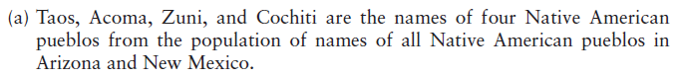
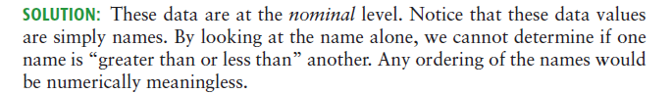
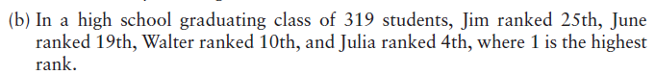
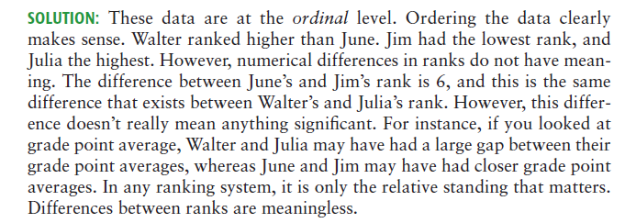
Exercise: Identifying data types
Notes:
10
10

Slide 11
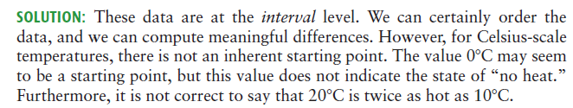
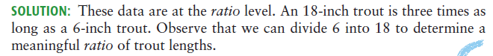
Exercise: Identifying data types
Notes:
11
11

Slide 12
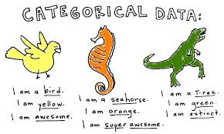
QUALITATIVE VARIABLE
DESCRIBED IN VERBALLY : (Profession, the type of business, the manufacturer of a car etc.)
Notes:
12
12

Slide 13
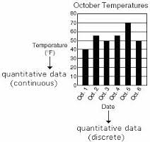
QUANTITATIVE VARIABLE
DESCRIBED IN MEANINGFUL NUMERICAL VALUES:
number of children in a family,
number of points scored in a game,
weight and height of childern,
investment return
Notes:
13
13

Slide 14
2. Descriptive Statistics
Summarizing data

Slide 15
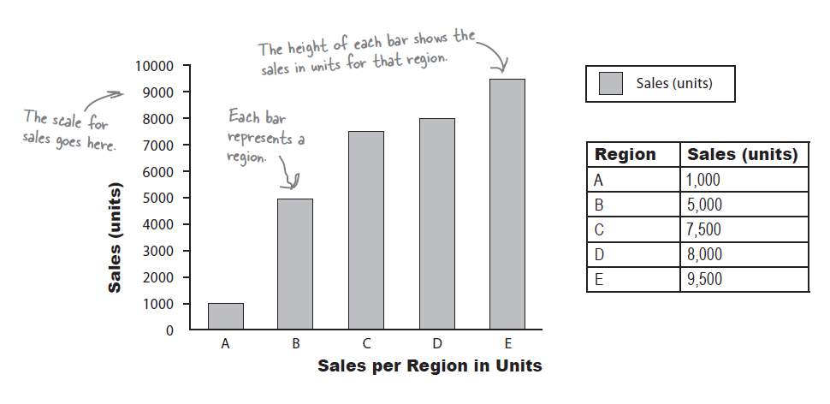
DESCRIPTIVE STATISTICS
SUMMARY OF A DATA SET IN THE FORMS OF TABLES, GRAPHS OR THE CALCULATION OF NUMERICAL MEASURES
Notes:
15
15

Slide 16
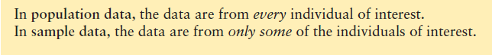
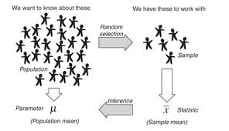
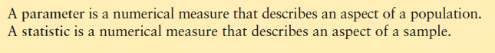
INFERENTIAL STATISTICS
EXTRACTING USEFUL INFORMATION FROM A SAMPLE TO DRAW CONCLUSIONS ABOUT A POPULATION
Notes:
16
16

Slide 17
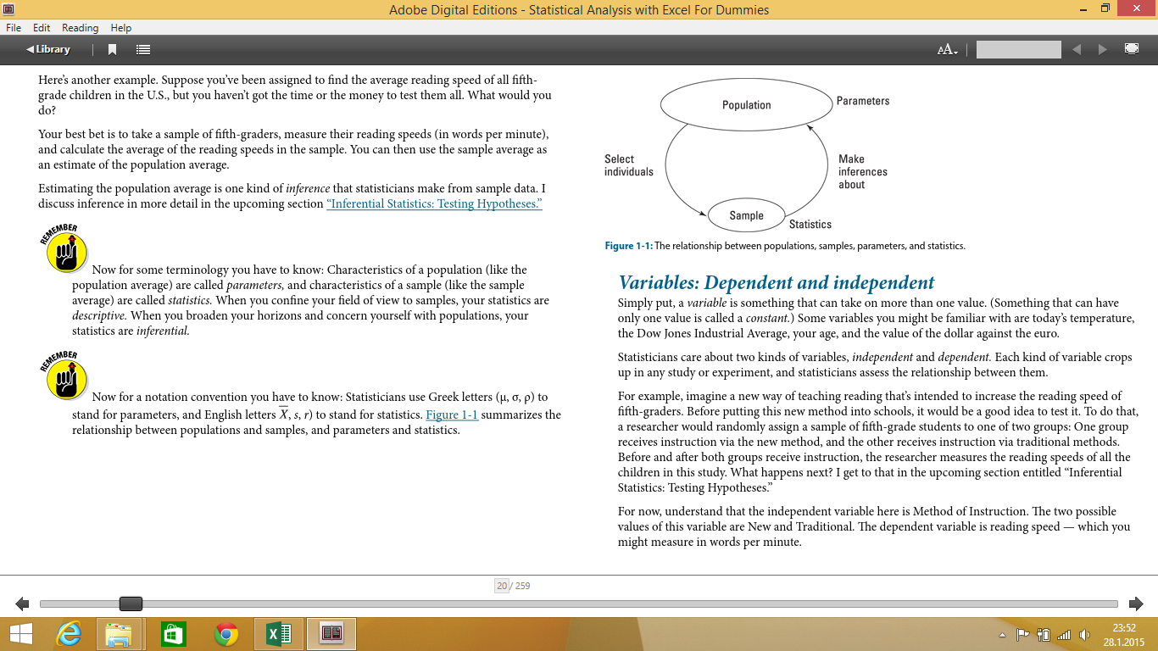
Population vs Sample
Notes:
17
17

Slide 18
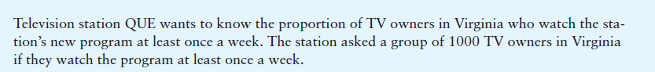
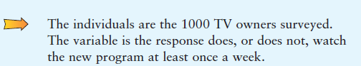
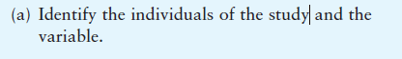
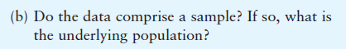
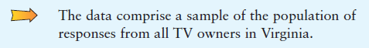
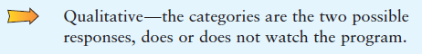
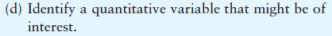

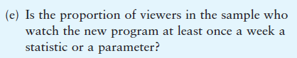
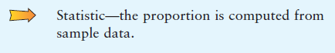
EXERCISE 1
Notes:
18
18

Slide 19
Summarizing data
Frequency
Relative frequency
Cumulative frequency
Percent frequency
Bar charts - Histogram
Notes:
19
19

Slide 20
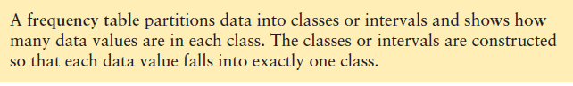
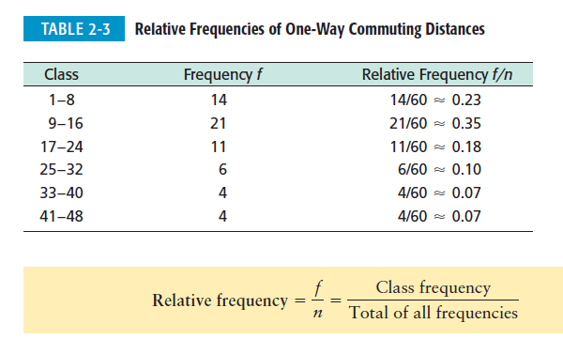
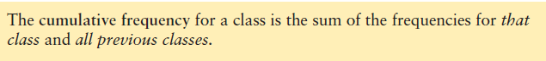
Summarizing data
When we have a large set of quantitative data, it’s useful to organize it into smaller intervals or classes and count how many data values fall into each class. A frequency table does just that.
Cumulative Frequency | Relative-Cum-Freq
14 | 0.233
35 | 0.583
46 | 0.767
52 | 0.867
56 | 0.933
60 | 1.000
Notes:
20
20

Slide 21
Frequency Distributions for Numerical Data
Three Steps to Define the Classes
1. Determine the number of overlapping classes
2. Determine the width of each class
3. Determine the class limits
Too many – too few
Notes:
21
21

Slide 22
. The Number of Overlapping Classes
Class(in$1000s) | Frequency
320 up to 350 | 2
350 up to 375 | 1
375 up to 400 | 1
400 up to 425 | 3
425 up to 450 | 5
450 up to 475 | 3
475 up to 500 | 0
500 up to 525 | 5
525 up to 550 | 5
550 up to 575 | 3
575 up to 600 | 1
600 up to 625 | 0
625 up to 650 | 1
650 up to 675 | 4
675 up to 700 | 0
700 up to 725 | 1
725 up to 750 | 1
Total | 36
Usually range from 5 to 20.
Too many classes:
Class(in$1000s) | Frequency
300 up to 450 | 12
450 up to 600 | 17
600 up to 750 | 7
Total | 36
Notes:
22
22

Slide 23
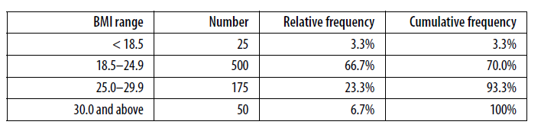
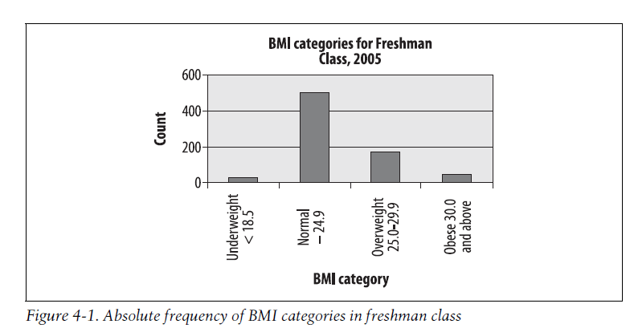
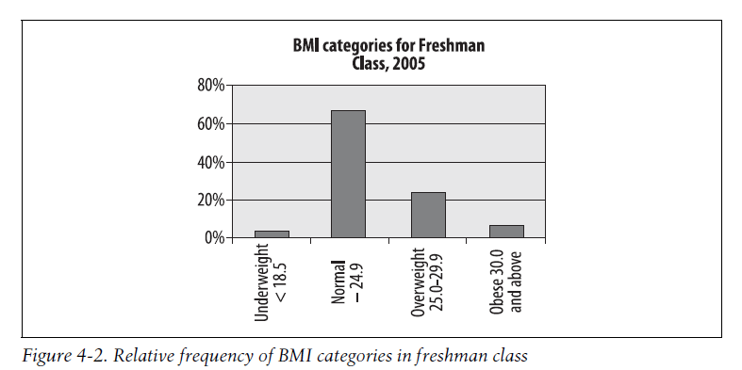
Visualizing Frequency Distributions for Numerical Data
Bar Charts
The bar chart is particularly appropriate for displaying discrete data with only a few categories
Body Mass Index (BMI),
Notes:
23
23

Slide 24
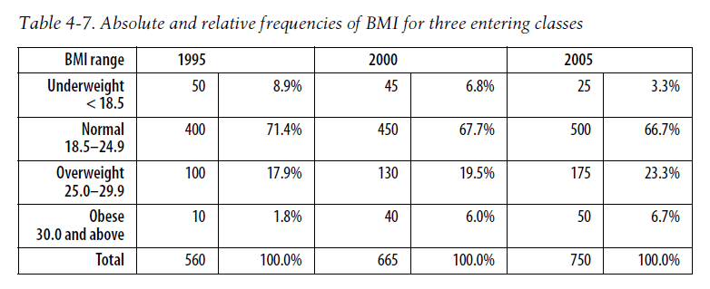
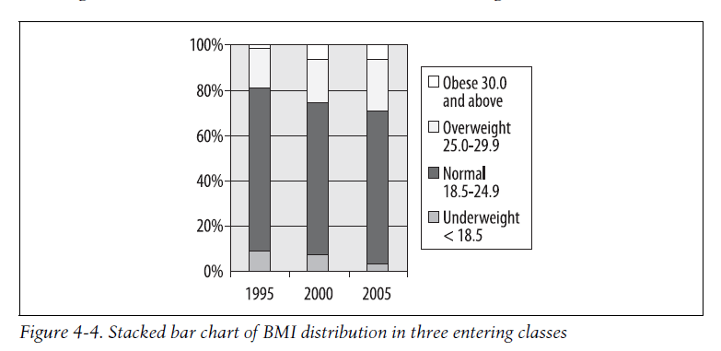
Visualizing Frequency Distributions for Numerical Data
Notes:
24
24

Slide 25
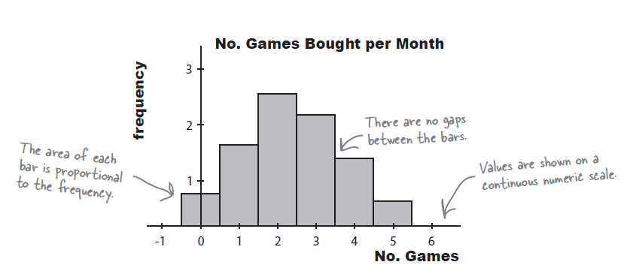
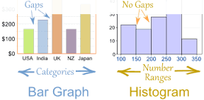
Visualizing Frequency Distributions for Numerical Data Histogram
Histograms are like bar charts but with two key differences.
The first is that the area of each bar is proportional to the frequency
The second is that there are no gaps between the bars on the chart.
Here’s an example of a histogram showing the average number of
games bought per month by households in Statsville:
Notes:
25
25

Slide 26
Visualizing Frequency Distributions for Numerical Data OGIVES
A graph that plots the cumulative frequency or the cumulative relative frequency of each class against the upper limit of the corresponding class
 | x-coordinate | y-coordinate
Classes
Lower end | 300 | 0
300-400 | 400 | 0,11
400-500 | 500 | 0,42
500-600 | 600 | 0,81
600-700 | 700 | 0,94
700-800 | 800 | 1
Notes:
26
26

Slide 27
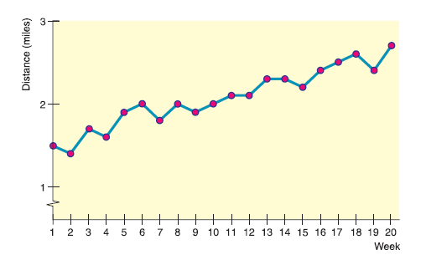
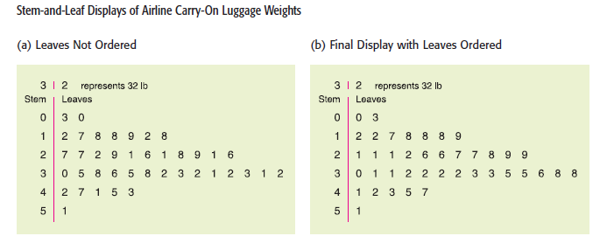
Visualizing Frequency Distributions for Numerical Data
Notes:
27
27

Slide 28
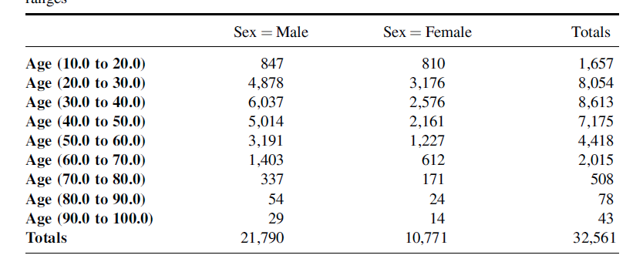
Crosstabulation
Notes:
28
28

Slide 29
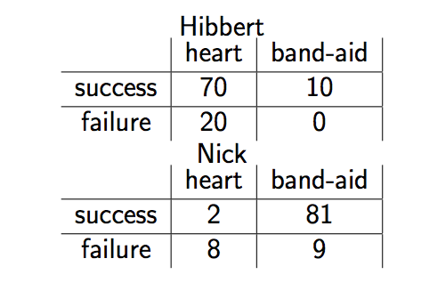
Simpson’s Paradox
Two doctors with following success rates, for two treatments (one easy one difficult)
Hibbert 80%, Nick: 83%
Notes:
29
29

Slide 30
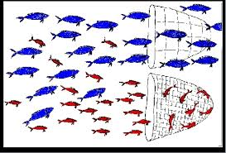
Simpson’s Paradox
When we combine all of the groups together, and look at the data in aggregate form, the correlation that we noticed before may reverse itself.
Notes:
30
30

Slide 31
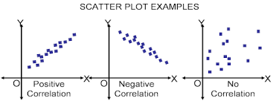
Scatter Plots
A graphical tool that helps in determining whether or not two variables are related in some systematic way
Each point in the diagram represents a pair of known or observed values of the two variables
Notes:
31
31

Slide 32
Scatter Plots
Individual | Education | Income
1 | 3 | 45
2 | 4 | 56
3 | 6 | 85
4 | 2 | 35
5 | 5 | 55
6 | 4 | 48
7 | 8 | 100
8 | 0 | 38
Notes:
32
32

Slide 33
Scatter Plots
Country | Income | Birth Rate
Madagaskar | 800 | 5,7
India | 3100 | 2,85
Mexico | 9600 | 2,49
Taiwan | 25300 | 1,57
Norway | 40000 | 1,78
Notes:
33
33

Slide 34
2. Descriptive Statistics
Measures of central tendency

Slide 35
Measures of central tendency
1. The Mean:
The sum of all the terms in a sample
=
The number of terms in the same sample
2. The Median:
The middle value of an ordered set of values
(or the mean of the middle two in a set with an even number of values)
3. The Mode:
The value that occurs most frequently in a random sample
Notes:
35
35

Slide 36
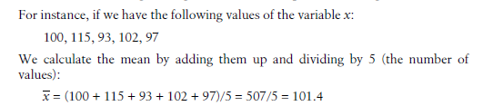
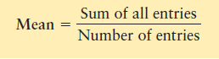
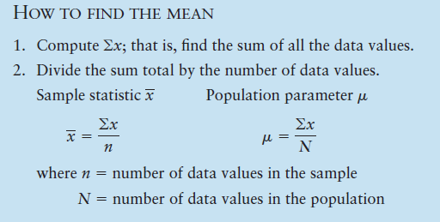
Mean
An average that uses the exact value of each entry is the mean (sometimes called the arithmetic mean). To compute the mean, we add the values of all the entries and then divide by the number of entries.
Notes:
36
36

Slide 37
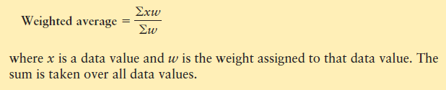
Weighted Average
Sometimes we wish to average numbers, but we want to assign more importance, or weight, to some of the numbers. For instance, suppose your professor tells you that your grade will be based on a midterm and a final exam, each of which is based on 100 possible points. However, the final exam will be worth 60% of the grade and the midterm only 40%. How could you determine an average score that would reflect these different weights?
The average you need is the weighted average.
Notes:
37
37

Slide 38
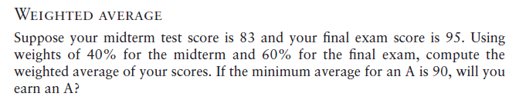
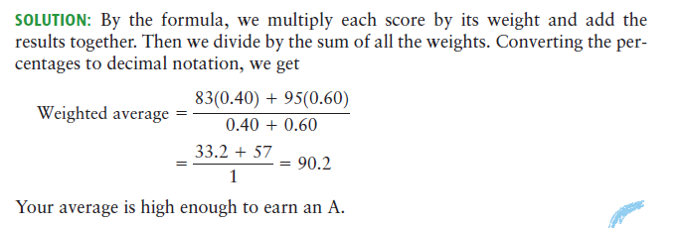
Weighted Average
Notes:
38
38

Slide 39
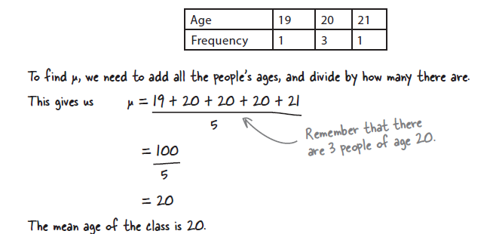
Handling frequencies
Notes:
39
39

Slide 40
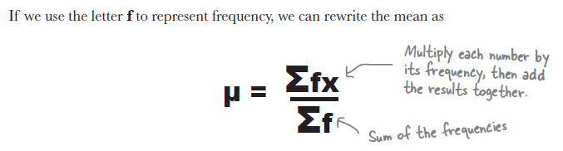
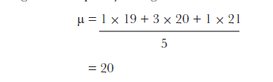
Handling frequencies
Notes:
40
40

Slide 41
Handling frequencies
Calculate the average class size in this city
School | Number of classes | Average class size
1 | 15 | 30
2 | 29 | 40
3 | 10 | 25
4 | 31 | 45
Notes:
41
41

Slide 42
Mean for grouped data
Sample mean
Population mean
f_{i}: frequency of that class
M_{i}: midpoint of the class
n: sample size
N: population size
Notes:
42
42

Slide 43
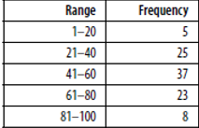
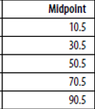

Handling frequencies
Notes:
43
43

Slide 44



Mod
Notes:
44
44

Slide 45

Median
Notes:
45
45

Slide 46


Median
Notes:
46
46

Slide 47


Median
Notes:
47
47

Slide 48
When do we use the different types? Measures of central tendency across types of data
Level of Measurement | Mode | Median | Mean
Nominal | ✓ | ❒ | ❒
Ordinal | ✓ | ✓ | ?
Scale (interval & ratio) | ✓ | ✓ | ✓
Notes:
48
48

Slide 49

When do we use the different types? Measures of central tendency across types of data
Notes:
49
49

Slide 50


Geometric Mean
Notes:
50
50

Slide 51
2. Descriptive Statistics
Bell-shaped Curves

Slide 52


Exercise:
How long does it take you to get to work?
How long does it take you to get into the office on a typical day, door to door?
NB: Answers like “too long” will be discarded as missing values. . . .
Notes:
52

Slide 53

Exercise: How long to get to work?
Respondent number | Number of minutes to work
1
2
3
4
5
6
7
8
9
10
11
12
13
14
15
16
17
18
19
20
21
22
23
Notes:
53

Slide 54

Our histogram: Journey times
Notes:
54

Slide 55
Gauss: The basis for modern statistics
An observation from Gauss (1777-1855). . . .
“Gauss decided to use a telescope to produce a more accurate calculation of the diameter of the moon. To his surprise, he discovered that every time he took a measurement, his answer was slightly different. He plotted the results and found that they formed a bell shaped curve, with most results close to the central average but the occasional one quite inaccurate.
Gauss quickly realised that any measurement he took was a ‘sample’ prone to error but which could be used as an estimate of the correct answer. The more readings he took, the closer the average would be to the correct reading. He established that errors in readings belonged to a curve.”
Notes:
55

Slide 56
What did Gauss’ Curve look like?
number
-ve below average
+ve
above average
average
Measurements taken
Notes:
56

Slide 57


The Bell-shaped curve: Normal distribution
With a perfect normal distribution, the mean, median and mode all converge
Mean, median and mode
Notes:
57

Slide 58
Key things to remember from this section (even if you forget everything else)
How to identify different types of data – nominal, ordinal etc
What a “normal” distribution looks like
Notes:
This is called the “normal distribution”.
Properties:
Bell shaped and symetrical
Mean = Median = Mode
58

Slide 59
2. Descriptive Statistics
Measures of dispersion

Slide 60

Measures of the spread in numerical data Variance and the standard deviation
Worked example: Beer versus gravity
Members of the public were asked to take part in an experiment. . . .
How many pints of premium export lager can you consume while standing up before you fall over?
Shane McGowan of the Pogues,
greasing the wheels while he thinks about what to have for breakfast
Notes:
60

Slide 61

Measures of the spread in numerical data Worked example: Beer versus gravity
Mean:
7.3 pints
Notes:
61

Slide 62

Measures of the spread in numerical data Why not just use the mean to summarise the sample?
Group 1:
Group 2:
Mean:
7.3 pints
Mean:
7.3 pints
Same mean, different
sample characteristics
Notes:
62

Slide 63
Option 1: The Range Subtract Minimum from Maximum value
One option to describe spread of scores is to calculate range
Max: 15 pints
= Max value – min value
Range = 14 pints
= 15 - 1
Mean:
7.3 pints
The range is 14 pints
An improvement on using the mean alone,
BUT it only takes into account 2 values in the sample
Min: 1 pint
Notes:
63

Slide 64
Option 2: Sum the deviations Add up all differences between each score and the mean
Calculate difference from the mean for each respondent (also called deviation or residual)
Gives an idea of the total spread throughout the sample
+7.7
+4.7
+2.7
+1.7
+0.7
Mean:
7.3 pints
-1.3
-0.3
Resp 1: Score (x₁) – Mean (x)
= 10 – 7.3
= +2.7
-3.3
-2.3
-4.3
-6.3
Total of the deviations:
= x₁ + x₂ + x₃ …..up to x_{n}
Notes:
64

Slide 65
Option 2: Sum the deviations Add up all differences between each score and the mean
BUT, there are 2 problems with this approach…..
1. If you sum the deviations and include the sign of the difference, the answer is always zero
+7.7
+4.7
+2.7
+1.7
+0.7
Mean:
7.3 pints
-1.3
-0.3
Total of the deviations:
= 2.7 + (-3.3) + (-4.3) etc. . .
= 0
-3.3
-2.3
-4.3
-6.3
Notes:
65

Slide 66
Option 2: Sum the deviations Add up all differences between each score and the mean
BUT, there are 2 problems with this approach…..
2. The bigger the sample, the bigger the total of the deviations could be…
+7.7
+4.7
+2.7
+1.7
+0.7
Mean:
7.3 pints
-1.3
-0.3
e.g. Total deviations for sample of 5, likely to be less than for sample of 10
-3.3
-2.3
-4.3
-6.3
Notes:
66

Slide 67
Option 3: The Variance Accommodate various sample sizes & direction of deviation
1. To deal with the problem of the total deviations being zero:
Square the deviations before adding them up. . . .
Negative differences become positive.
+7.7
+4.7
+2.7
+1.7
+0.7
Mean:
7.3 pints
-1.3
-0.3
-3.3
-2.3
-4.3
Total of the squared deviations:
= (x₁)² + (x₂)² + (x₃)² …to (x_{n})²
= (+2.7)² + (-3.3)² + (-4.3)² …etc
= 7.4 + 10.7 + 18.3 …etc
= 168.2 pints²
-6.3
Notes:
67

Slide 68
Option 3: The Variance Accommodate various sample sizes & direction of deviation
2. To account for the size of the sample:
Simply divide the total squared deviations by the number of respondents. . . .
+7.7
+4.7
+2.7
+1.7
+0.7
Mean:
7.3 pints
-1.3
-0.3
-3.3
-2.3
-4.3
Sample n = 11,
Therefore our sample variance is:
= 168.2 / 11
= 15.3 pints²
-6.3
Notes:
68

Slide 69
Option 4: The Standard Deviation Adjust the variance to match the units used in the sample
Variance gives a good measure of distribution and takes into account ALL scores in the sample
Statisticians often use the variance in their calculations
+7.7
+4.7
+2.7
+1.7
+0.7
Mean:
7.3 pints
-1.3
-0.3
-3.3
-2.3
-4.3
But, to match the original units, take the square root of the variance:
Variance (s²) = 15.3 pints²
Standard deviation (s) = √15.3
= 3.9 pints
-6.3
Notes:
69

Slide 70
Option 4: The Standard Deviation How does this vary with sample characteristics?
Group 1:
Group 2:
+1 sd:
11.2 pints
+1 sd:
8.1 pints
Mean:
7.3 pints
Mean:
7.3 pints
-1 sd:
6.5 pints
-1 sd:
3.4 pints
1 sd = 3.9 pints
1 sd = 0.8 pints
Notes:
70

Slide 71
The Equation for Standard Deviation
Calculating standard deviation (often abbreviated to “s” or “sd”) can be done manually using the following equation:
√
Σ(x_{i} – x)²
s =
n – 1
There is absolutely no need to remember this formula!
For those of you interested:
x_{i} is the score obtained for the ith respondent
x is the mean for your total sample
n is the total number of respondents in your sample
Σ means “add up all possible values” of x, i.e. (x₁ – x)² + (x₂ – x)²…etc
Another way of writing all the steps we just took to calculate the sd. . . .
Notes:
71

Slide 72
Key things to remember from this section (even if you forget everything else)
That a dispersion of scores can be an important aspect of your data that isn’t summarised by the mean alone
Understand that we are referring to the spread of scores in a sample when we talk about standard deviation
The bigger the standard deviation, the greater the spread of scores!
Notes:
This is called the “normal distribution”.
Properties:
Bell shaped and symetrical
Mean = Median = Mode
72

Slide 73


Summary
Notes:
73
73

Slide 74
Variance for grouped data
Sample Variance
Population Variance
Notes:
74
74

Slide 75
Variance for grouped data
Days | Class Midpoint (M_{i}) | Frequency (f_{i}) | Deviation(M_{i}-) | Squared deviation | f_{i}*squared dev
10-14 | 12 | 4 | -7 | 49 | 196
15-19 | 17 | 8 | -2 | 4 | 32
20-24 | 22 | 5 | 3 | 9 | 45
25-29 | 27 | 2 | 8 | 64 | 128
30-34 | 32 | 1 | 13 | 169 | 169
 | total | 20 | 15 | 295 | 570
 | sample mean | 19
 | sample variance | 30
Notes:
75
75

Slide 76

Coefficient of Variation
A disadvantage of the standard deviation as a comparative measure of variation is that it depends on the units of measurement. This means that it is difficult to use the standard deviation to compare measurements from different populations. For this reason, statisticians have defined the coefficient of variation, which expresses the standard deviation as a percentage of the sample or population mean.
Notes:
76
76

Slide 77




Interquartile Range(IQR)
Notes:
77
77

Slide 78




Interquartile Range(IQR)
The lowest quartile is known as the lower quartile, or first quartile
(Q1),
The highest quartile is known as the upper quartile, or third quartile (Q3).
The quartile in the middle (Q2) is the median, as it splits the data in half.
The range of the values in these two quartiles is called the interquartile range (IQR).
Notes:
78
78

Slide 79


We’re not just limited to quartiles
Percentiles?
Percentiles are values that split your data into percentages in the same way that quartiles split data into quarters. Each percentile is referred to by the percentage with which it splits the data, so the 10th percentile is the value that is 10% of the way through the data.
Quartiles are actually a type of percentile. The lower quartile is P25, and the upper quartile is P75. The median is P50.
Notes:
79
79

Slide 80
2. Descriptive Statistics
Measures of distribution shape

Slide 81




Skewness
Right skewed
Left skewed
Notes:
81
81

Slide 82

Skewness
Skewness is a measure of the asymmetry of the probability distribution of a random variable about its mean. In other words, skewness tells you the amount and direction of skew (departure from horizontal symmetry).
The skewness value can be positive or negative, or even undefined. If skewness is 0, the data are perfectly symmetrical, although it is quite unlikely for real-world data. As a general rule of thumb:
If skewness is less than -1 or greater than 1, the distribution is highly skewed.
If skewness is between -1 and -0.5 or between 0.5 and 1, the distribution is moderately skewed.
If skewness is between -0.5 and 0.5, the distribution is approximately symmetric.
Notes:
82
82

Slide 83



Kurtosis
Notes:
83
83

Slide 84

z-Scores
Imagine a situation in which you have two basketball players of different ability. The first player gets the ball into the net an average of 70% of the time, and he has a standard deviation of 20%. The second player has a mean of 40% and a standard deviation of 10%.
we can achieve
this with the standard score, or z-score.
Notes:
84
84

Slide 85


z-Scores
Notes:
85
85

Slide 86


z-Scores
Notes:
86
86

Slide 87



Chebyshev’s Theorem
Notes:
87
87

Slide 88
2. Descriptive Statistics
Five number summary and Box plots

Slide 89
Outliers
An outlier is an observation point that is distant from other observations
An outlier may be due to variability in the measurement or it may indicate experimental error;
the latter are sometimes excluded from the data set
Outliers can occur by chance in any distribution, but they often indicate either
Measurement error (discard)
That the population has a heavy-tailed distribution
Notes:
89
89

Slide 90
How to detect outliers
Subjective
Visualization
Objective
Variance based methods
Clustering based methods
Any value having more than 3 or less then -3 z-score can be identified as outlier
Notes:
90
90

Slide 91
Five number summary
Smallest value
First quartile (Q₁)
Median
Third quartile (Q₃)
Largest value
Notes:
91
91

Slide 92
Box plots
A graphical summary
Q₁, Q₂ (median) Q₃, and IQR
Lower limit = Q₁ – 1.5 IQR
Upper limit = Q₃ + 1.5 IQR
Points that lie below lower limit and above upper limit are considered as outlier
Notes:
92
92

Slide 93

Box and Whisker Plots(Box-Plot)
Smallest value within limits
Largest value within limits
Notes:
93
93

Slide 94

Notes:
94
94
Player A has a relatively small range, and his median score is a bit higher than Player B’s.
Player B has a very large range. Sometimes this player scores a lot higher than Player A, but sometimes a lot lower.
Player A plays more consistently and usually scores higher than Player B (compare the medians and interquartile range), so we’d pick Player A.

Slide 95

Comparative analysis using box plots
Notes:
95
95

Slide 96
2. Descriptive Statistics
Measures of association between two variables

Slide 97
Measuring relationships in your data
Consider a situation in which you want to test whether there is a relationship between 2 scale variables
Suppose we want to test whether the number of packets of crisps someone purchases is related to the number of adverts for these crisps they have seen on television
Respondent | 1 | 2 | 3 | 4 | 5 | Mean | Std Dev.
Crisp packets bought | 8 | 9 | 10 | 13 | 15 | 11.0 | 2.92
Adverts watched | 5 | 4 | 4 | 6 | 8 | 5.4 | 1.67
Notes:
97

Slide 98
Covariance
The simplest way to measure the relationship between these two variables is to see how much they co-vary
For example, if one variable deviates away from the mean, does the same happen in the other?
Covariance looks at the variance of both variables and provides a measure of the extent to which they vary together
X
Y
X
Y
Notes:
98

Slide 99
Variance and Covariance
To understand how covariance works, it is useful to look back at the equation for variance we discussed earlier:
Σ(x_{i} – x)²
Variance, s² =
n – 1
This is the same as writing:
Σ(x_{i} – x)(x_{i} – x)
s² =
n – 1
Notes:
99

Slide 100
Variance and Covariance
To see how two variables (x and y) co-vary, we can substitute y into this equation:
Σ(x_{i} – x)(y_{i} – y)
cov (x,y) =
n – 1
This is basically the same as writing:
Σ (difference from mean for “x”) x (difference from mean for “y”)
cov (x,y) =
n – 1
Notes:
100

Slide 101

What would our covariance look like?
Often, the best way to visualise a relationship in your data is to show the x and y values in a scatter plot, and add the line of best fit
But what does this line tell us?
Adverts watched
Crisp packets bought
Notes:
101

Slide 102
Covariance and types of relationship
When:
X
Y
and
X
Y
Positive covariance
When:
X
Y
and
X
Y
Negative covariance
Zero covariance
(no linear relationship)
When:
X
Y
and
X
Y
Notes:
102

Slide 103

Exercise: Crisp adverts
Respondent | 1 | 2 | 3 | 4 | 5 | Mean | Std Dev.
Crisp packets bought (x) | 8 | 9 | 10 | 13 | 15 | 11.0 | 2.92
Adverts watched (y) | 5 | 4 | 4 | 6 | 8 | 5.4 | 1.67
Calculate the covariance
for these variables
+4
+2
Packets bought,
Mean = 11.0
-2
-1
-3
Σ(x_{i} – x)(y_{i} – y)
cov (x,y) =
n – 1
Packets bought / Adverts watched
+2.6
(-0.4 x -3) + (-1.4 x -2) ….. etc
+0.6
Adverts watched,
Mean = 5.4
=
-0.4
-1.4
-1.4
n – 1
1.2 + 2.8 + 1.4 +1.2 + 10.4
=
4
=
4.25
Respondent
Notes:
103

Slide 104
Standardisation and the correlation coefficient
Covariance is useful in that it tells us whether there is a relationship between 2 variables and whether it is positive or negative
However, one major problem with covariance is that the result is entirely dependent on the scale of the variables used.
One covariance result cannot be compared to another
The easiest way to account for the differences in units used is to standardise the measures based on their standard deviations
This gives us the correlation coefficient (r) between the two variables
Notes:
104

Slide 105
Correlation: Crisp adverts
Respondent | 1 | 2 | 3 | 4 | 5 | Mean | Std Dev.
Crisp packets bought (x) | 8 | 9 | 10 | 13 | 15 | 11.0 | 2.92
Adverts watched (y) | 5 | 4 | 4 | 6 | 8 | 5.4 | 1.67
The correlation coefficient:
+4
+2
Packets bought,
Mean = 11.0
-2
-1
-3
Σ(x_{i} – x)(y_{i} – y)
r =
n – 1 (s_{x}s_{y})
Packets bought / Adverts watched
+2.6
(-0.4 x -3) + (-1.4 x -2) ….. etc
+0.6
Adverts watched,
Mean = 5.4
=
-0.4
-1.4
-1.4
n – 1 x (2.92 x 1.67)
1.2 + 2.8 + 1.4 +1.2 + 10.4
=
4 x (4.88)
=
0.872
Respondent
Notes:
105

Slide 106
Correlation behaves in the same way as covariance…..but limited from -1 to +1
When:
X
Y
and
X
Y
r >0, up to +1
Positive correlation, r is above 0 and up to maximum of 1
r <0, down to -1
When:
X
Y
and
X
Y
Negative correlation, r is below 0 and down to minimum of -1
r = 0
When:
X
Y
and
X
Y
No correlation, r is 0 (or close to zero)
Notes:
106

Slide 107

Rules of thumb: Correlation strength
Moderate
Mild
Negligible
Mild
Moderate
Strong
Attribute 1
Attribute 2
Attribute 3
Attribute 4
Attribute 5
Attribute 6
Attribute 7
Attribute 8
Attribute 9
Attribute 10
Attribute 11
Attribute 12
Attribute 13
Attribute 14
A value of r below 0.2 is weak or negligible, above 0.2 is mild, above 0.4 is moderate and above 0.6 represents a strong relationship
Notes:
107

Slide 108
Discussion (Volume)
Suppose we have data distributed across 1000 different computers,
How to generate descriptive statistics in parallel
Frequency, relative frequency
Mean, median, mode, quartiles
Range, IQR, Variance
Detect outliers in parallel
Notes:
108
108

Slide 109
Discussion 2 (Velocity)
Suppose you have continuous data input for 1000 computers
How to generate descriptive statistics in parallel
Frequency, relative frequency
Mean, median, mode, quartiles
Range, IQR, Variance
Detect outliers
Notes:
109
109

Slide 110
Discussion 2 (Velocity)
Suppose you have continuous data input for 1000 computers
How to generate descriptive statistics in parallel
Frequency, relative frequency
Mean, median, mode, quartiles
Range, IQR, Variance
Detect outliers
Notes:
110
110

